Slide 1
File and Input/output Streams

Slide 2
Text I/O vs Binary I/O
Data stored in a binary file are represented in binary form. You cannot read binary files. They are designed to be read by programs.
Computers do not differentiate binary files and text files. All files are stored in binary format, and thus all files are essentially binary files.
Text I/O is built upon binary I/O to provide a level of abstraction for character encoding and decoding.
Encoding and decoding are automatically performed by the for text I/O.

Slide 3
Streams
Java programs perform I/O through streams. A stream is an abstraction that either produces or consumes information.
A stream is linked to a physical device by the Java I/O system.
All streams behave in the same manner, even if the actual physical devices to which they are linked differ. Thus, the same I/O classes and methods can be applied to any type of device.
All these streams represent an input source and an output destination

Slide 4
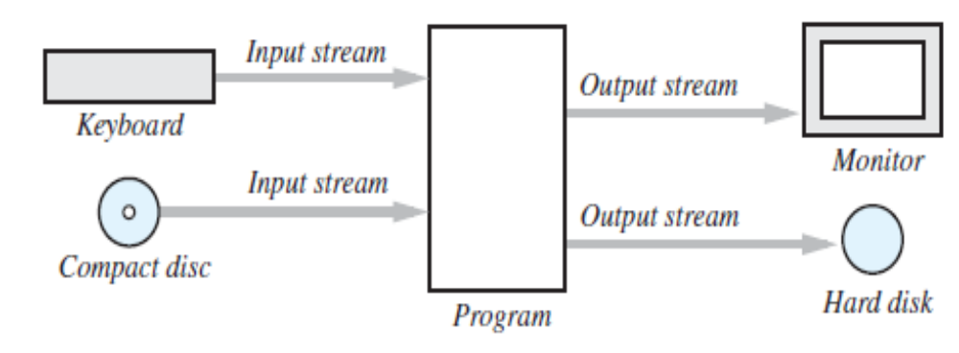
The Concept of a Stream
A stream is a flow of data. The data might be characters, numbers, or bytes consisting of binary digits.
If the data flows into your program, the stream is called an input stream.
If the data flows out of your program, the stream is called an output stream.
For example, if an input stream is connected to the keyboard, the data flows from the keyboard into your program. If an input stream is connected to a file, the data flows from the file into your program. Figure below illustrates some of these streams.

Slide 5
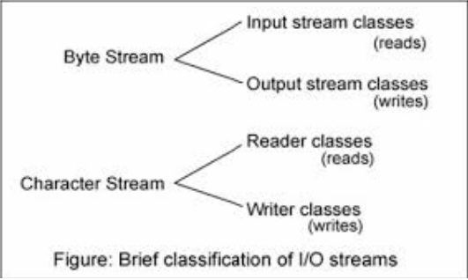
Byte Streams and Character Streams
Java defines two types of streams: byte and character.
Byte streams provide a convenient means for handling input and output of bytes. Byte streams are used, for example, when reading or writing binary data.
Character streams provide a convenient means for handling input and output of characters.
At the lowest level, all I/O is byte-oriented. The character-based streams simply provide a convenient and efficient means for handling characters.

Slide 6
The Byte Stream Classes
Byte streams are defined by using two class hierarchies. At the top are two abstract classes: InputStream and OutputStream.
Each of these abstract classes has several concrete subclasses that handle the differences between various devices, such as disk files, network connections, and even memory buffers.
The abstract classes InputStream and OutputStream define several key methods that the other stream classes implement. Two of the most important are read( ) and write( ), which, respectively, read and write bytes of data.
Both methods are declared as abstract inside InputStream and OutputStream. They are overridden by derived stream classes.

Slide 7
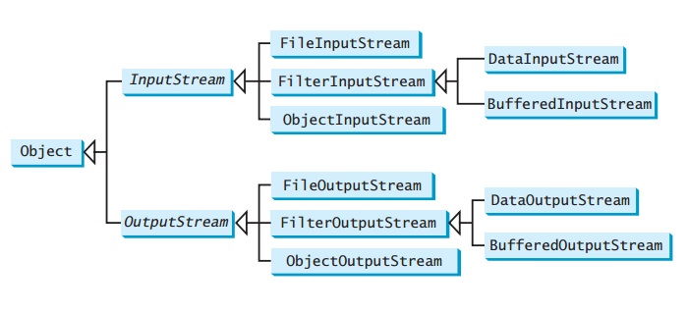
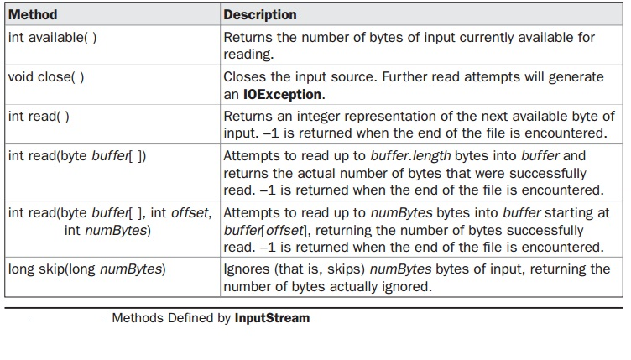

Slide 8
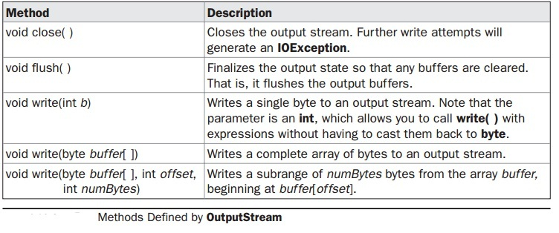

Slide 9
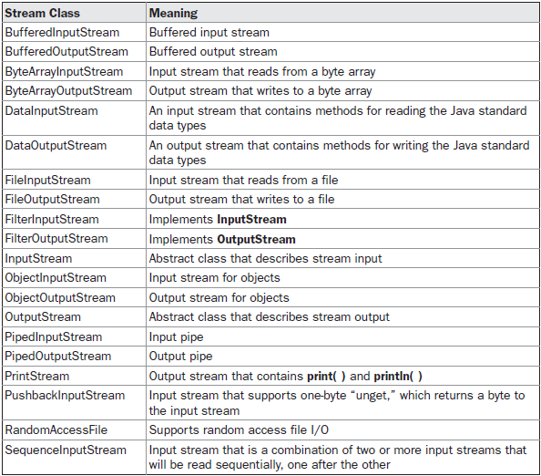
The Byte Stream Classes

Slide 10
The Character Stream Classes
Character streams are defined by using two class hierarchies. At the top are two abstract classes, Reader and Writer.
These abstract classes handle Unicode character streams. Java has several concrete subclasses of each of these.
The abstract classes Reader and Writer define several key methods that the other stream classes implement. Two of the most important methods are read( ) and write( ).

Slide 11
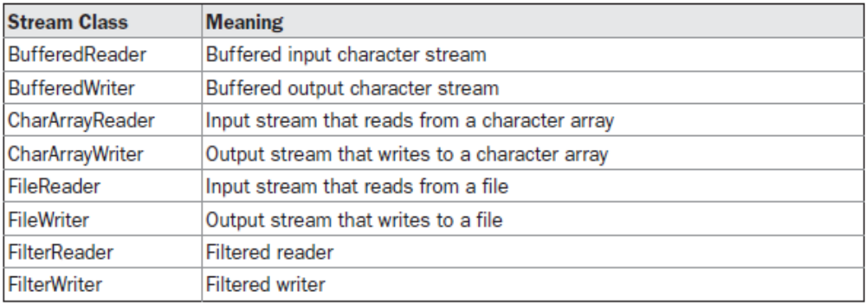
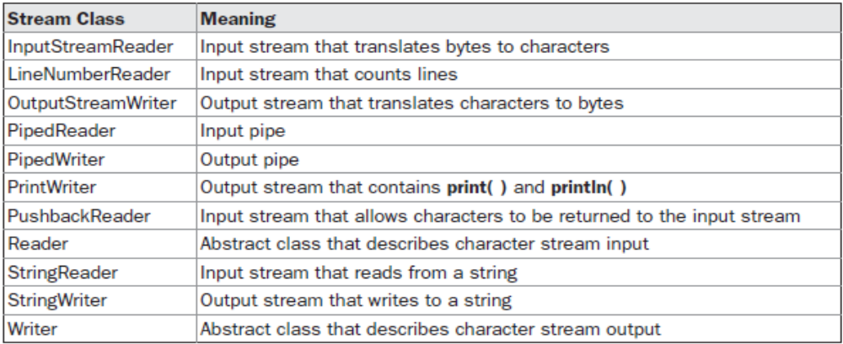
The Character Stream Classes

Slide 12
The Predefined Streams
As all Java programs automatically import the java.lang package. This package defines a class called System, which encapsulates several aspects of the run-time environment.
For example, using some of its methods, we can obtain the current time and the settings of various properties associated with the system.
System also contains three predefined stream variables: in, out, and err.
These fields are declared as public, static, and final within System.
System.out refers to the standard output stream. By default, this is the console. System.in refers to standard input, which is the keyboard by default. System.err refers to the standard error stream, which also is the console by default.
System.in is an object of type InputStream; System.out and System.err are objects of type PrintStream. These are byte streams, even though they typically are used to read and write characters from and to the console. As we can wrap these within character based streams, if desired.

Slide 13
FileInputStream
The FileInputStream class creates an InputStream that you can use to read bytes from a file. Its two most common constructors are shown here:
FileInputStream(String filepath)
FileInputStream(File fileObj)
Both can throw a FileNotFoundException. Here,filepath is the full path name of a file, and fileObj is a File object that describes the file.

Slide 14
import java.io.*;
public class InputStreamDemo
{ public static void main(String[] args) throws IOException
{ FileInputStream fis = null;
int i = 0;
char c;
try
{ fis = new FileInputStream("test.txt");
while((i=fis.read())!=-1)
{
c=(char)i;
System.out.print(c);
}
}
catch(FileNotFoundException ex){ }
finally{ if(fis!=null)
fis.close();
}
}
}

Slide 15
FileOutputStream
FileOutputStream creates an OutputStream that you can use to write bytes to a file. Its most commonly used constructors are shown here:
FileOutputStream(String filePath)
FileOutputStream(File fileObj)
FileOutputStream(String filePath, boolean append)
FileOutputStream(File fileObj, boolean append)
They can throw a FileNotFoundException. Here, filePath is the full path name of a file, and fileObj is a File object that describes the file. If append is true, the file is opened in append mode.
Creation of a FileOutputStream is not dependent on the file already existing. FileOutputStream will create the file before opening it for output when you create the object. In the case where you attempt to open a read-only file, an IOException will be thrown.

Slide 16
Closing a stream when it's no longer needed is very important — A finally block to guarantee that streams will be closed even if an error occurs. This practice helps avoid serious resource leaks.
Since test.txt contains character data, the best approach is to use character streams. There are also streams for more complicated data types. Byte streams should only be used for the most primitive I/O.

Slide 17
import java.io.*;
public class OutputStreamDemo
{
public static void main(String[] args) throws IOException
{
FileOutputStream fos = null;
String s = "This text will be written in the file";
byte buf[] = s.getBytes();
try
{
fos = new FileOutputStream("test1.txt");
for (int i=0; i < buf.length; i++)
{
fos.write(buf[i]);
}
}catch(FileNotFoundException e){}
finally
{
fos.close();
}
}
}

Slide 18
Character Streams
The Java platform stores character values using Unicode conventions. Character stream I/O automatically translates this internal format to and from the local character set.
For most applications, I/O with character streams is no more complicated than I/O with byte streams. Input and output done with stream classes automatically translates to and from the local character set.
Character streams are defined by using two class hierarchies.
At the top are two abstract classes, Reader and Writer.
These abstract classes handle Unicode character streams.
Similar to Byte Streams, read() and write() methods are defined in Reader and Writer class.

Slide 19
The Character Stream Classes

Slide 20
PrintWriter Class
Although using System.out to write to the console is acceptable.
The recommended method of writing to the console when using Java is through a PrintWriter stream.
PrintWriter is one of the character-based classes.
Using a character-based class for console output makes it easier to internationalize your program.
PrintWriter(OutputStream outputStream)
PrintWriter(OutputStream outputStream, boolean flushOnNewline)
PrintWriter(Writer outputStream)
PrintWriter(Writer outputStream, Boolean flushOnNewline)

Slide 21
outputStream is an object of type OutputStream.
flushOnNewline controls whether Java flushes the output stream every time a println( )method is called.
If flushOnNewline is true, flushing automatically takes place.
If false, flushing is not automatic.
PrintWriter supports the print( ) and println( ) methods for all types including Object. Thus, we can use these methods in the same way as they have been used with System.out.
If an argument is not a simple type, the PrintWriter methods call the object’s toString( ) method and then print the result.

Slide 22
Using PrintWriter
import java.io.*;
public class PrintWriterDemo
{
public static void main(String args[])
{
PrintWriter pw = new PrintWriter(System.out, true);
pw.println(“Using PrintWriter Object");
int i = -7;
pw.println(i);
double d = 4.5e-7;
pw.println(d);
}
}

Slide 23
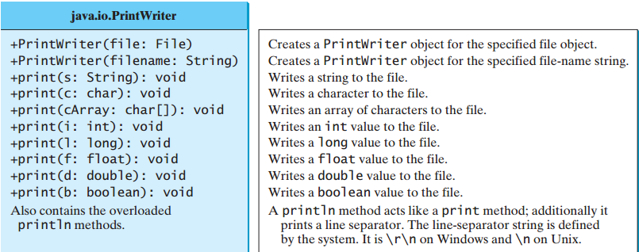
Writing Data into file using PrintWriter
The java.io.PrintWriter class can be used to create a file and write data to a text file.
PrintWriter output = newPrintWriter(filename);
Then, you can invoke the print,println methods on PrintWriter object

Slide 24
public class PrintWriterDemo
{
public static void main(String[] args) throws Exception {
java.io.File f = new java.io.File("b.txt");
java.io.PrintWriter output = new java.io.PrintWriter(f);
output.print("Java class ");
output.println(40);
output.print("LPU ");
output.println(85.5);
output.print('a');
output.close();
}
}

Slide 25
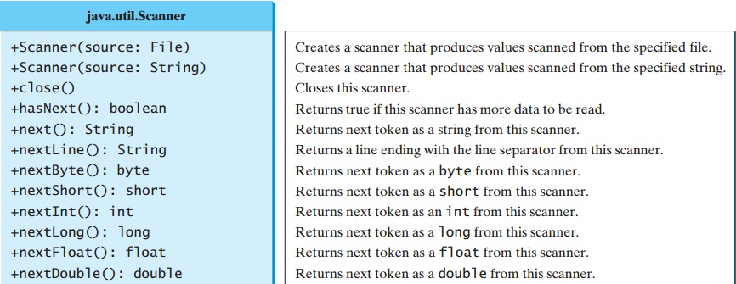
Reading file Using Scanner
The java.util.Scanner class was used to read strings and primitive values from the console
Scanner input = new Scanner(System.in);
To read from a file, create a Scanner for a file, as follows:
Scanner input = new Scanner(new File(filename));

Slide 26
import java.util.Scanner;
public class ReadFile {
public static void main(String[] args) throws IOException
{
java.io.File file = new java.io.File("b.txt");
Scanner input = new Scanner(file);
while(input.hasNext())
{
String s = input.nextLine();
System.out.println(s);
}
input.close();
}
}

Slide 27
Serialization
Serialization is the process of writing the state of an object to a byte stream.
This is useful when we want to save the state of our program to a persistent storage area, such as a file.
At a later time, we may restore these objects by using the process of de-serialization.

Slide 28
An object to be serialized may have references to other objects, which, in turn, have references to still more objects.
If we attempt to serialize an object at the top of an object graph, all of the other referenced objects are recursively located and serialized.

Slide 29
Serialization: Interfaces and Classes
An overview of the interfaces and classes that support serialization follows:
Serializable
  Only an object that implements the Serializable interface can be saved and restored by the serialization facilities.
  The Serializable interface defines no members.
  It is simply used to indicate that a class may be serialized.
  If a class is serializable, all of its subclasses are also serializable.

Slide 30
ObjectOutput
The ObjectOutput interface extends the DataOutput interface and supports object serialization.
It defines the methods several methods. All of these methods will throw an IOExceptionon error conditions.
writeObject( )method is called to serialize an object.
ObjectOutputStream
The ObjectOutputStream class extends the OutputStream class and implements the ObjectOutput interface.
It is responsible for writing objects to a stream. Constructor is:
ObjectOutputStream(OutputStream outStream) throws IOException
The argument outStream is the output stream to which serialized objects will be written.

Slide 31
Serialization Example
class MyClass implements Serializable
{
String s;
int i;
double d;
public MyClass(String s, int i, double d) {
this.s = s;
this.i = i;
this.d = d;
}
public String toString()
{
return "s=" + s + "; i=" + i + "; d=" + d;
}
}

Slide 32
import java.io.*;
public class SerializationDemo {
public static void main(String args[]) {
try {
MyClass object1 = new MyClass("Hello", -7, 2.70);
System.out.println("object1: " + object1);
FileOutputStream fos = new FileOutputStream("serial");
ObjectOutputStream oos = new ObjectOutputStream(fos);
oos.writeObject(object1);
oos.flush();
oos.close();
}
catch(IOException e) {
System.out.println("Exception during serialization: " + e);
System.exit(0);
}

Slide 33
// Object deserialization
try {
MyClass object2;
FileInputStream fis = new FileInputStream("serial");
ObjectInputStream ois = new ObjectInputStream(fis);
object2 = (MyClass)ois.readObject();
ois.close();
System.out.println("object2: " + object2);
}
catch(Exception e) {
System.out.println("Exception during deserialization: " + e);
System.exit(0);
}
}
}

